Slide 1
Semantic Segmentation for Self Driving Cars
Prasad Naik

Slide 2
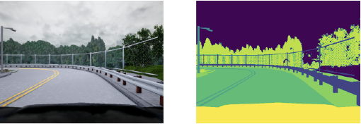
Semantic Segmentation
Deep Learning Algorithm
Process of partitioning a digital image into multiple image segments
Associates a label or category with every pixel in an image
Applications: Medical Image Analysis, Autonomous Vehicles, Satellite Image Analysis

Slide 3
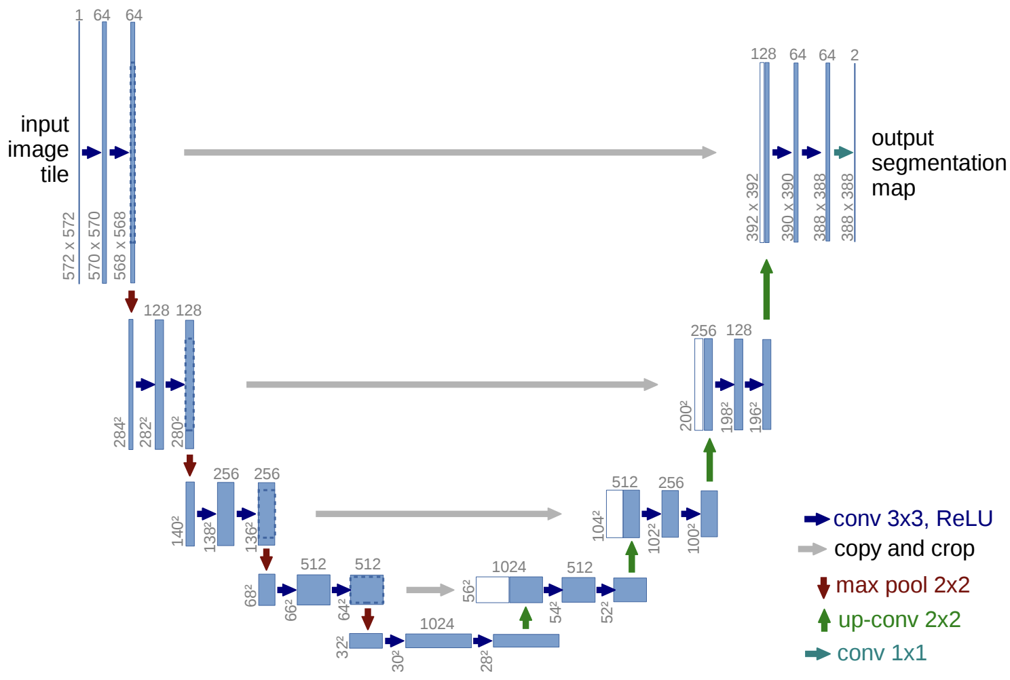
U-Net

Slide 4
U-Net: Encoder

Slide 5
U-Net: Bottleneck

Slide 6
U-Net: Decoder

Slide 7
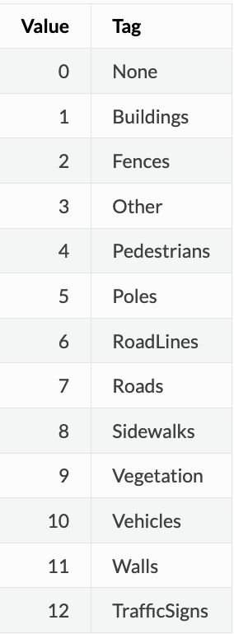
Data
CARLA (CAR Learning to Act) Self Driving Simulator
Lyft - Udacity Challenge
Images and Segmentation Maps
Source: Kaggle
5 sets of 1000 Images and corresponding label
13 classes

Slide 8
Dataset Distribution Overview
Dataset Type | Samples
Train | 4000
Validation | 800
Test | 200

Slide 9








Tools & Technologies
Python | Tensorflow | Keras | Numpy | Matplotlib | HDF5 | Scikit-learn | GPU
3.10.12 | 2.14.0 | 2.14.0 | 1.23.5 | 3.7.1 | 3.9.0 | 1.2.2 | Tesla V100

Slide 10
Experiments
Optimizer | Learning Rate | Loss | Epochs | Metric
Adam | 0.01 | Sparse Categorical Cross Entropy | 15 | Accuracy
SGD | 0.01 | Sparse Categorical Cross Entropy | 20 | Accuracy
AdaGrad | 0.01 | Sparse Categorical Cross Entropy | 30 | Accuracy

Slide 11
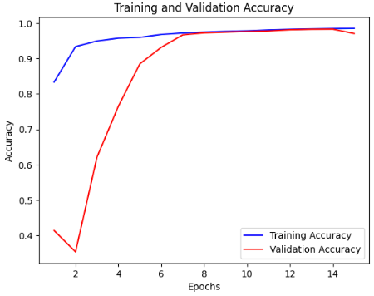
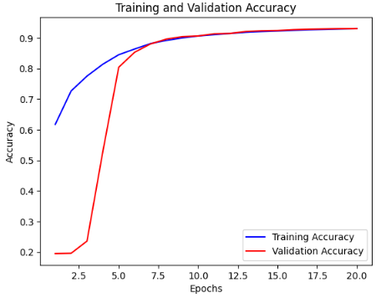
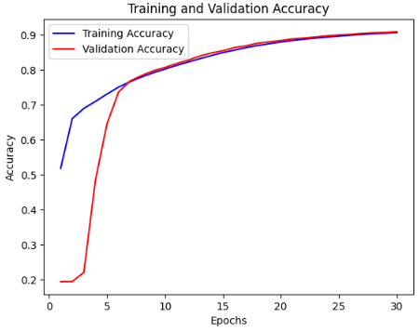
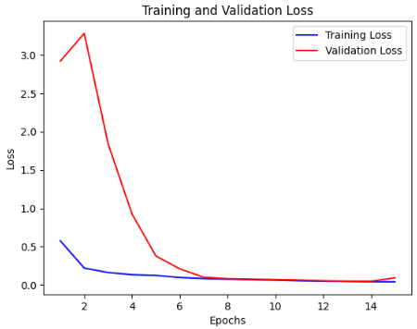
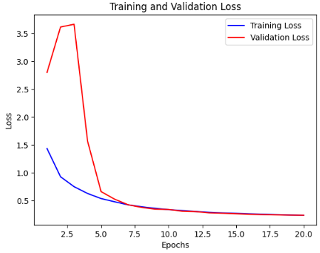
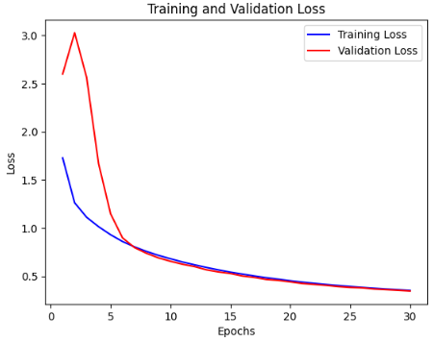
Experiments: Accuracy and Loss
Adam
SGD
AdaGrad

Slide 12
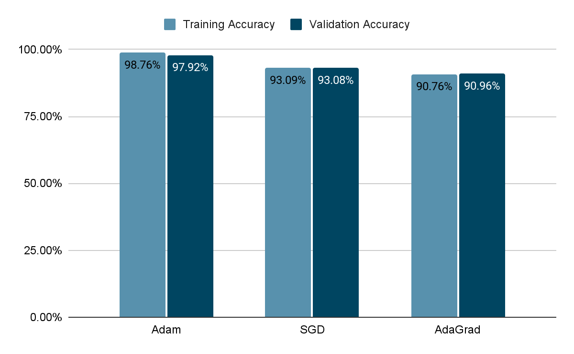
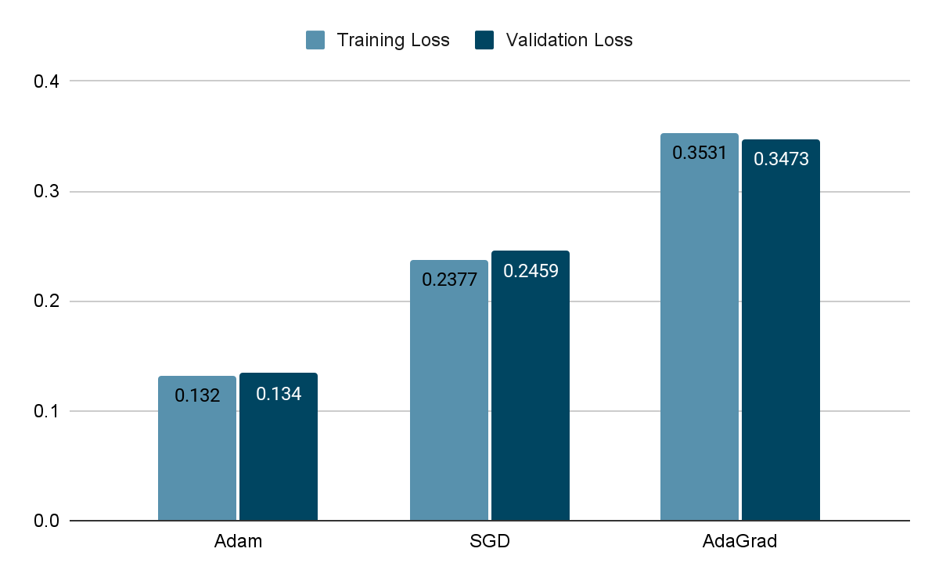
Experiments: Accuracy and Loss

Slide 13
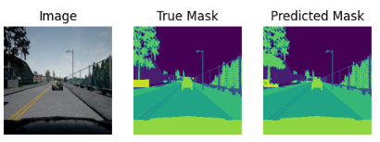
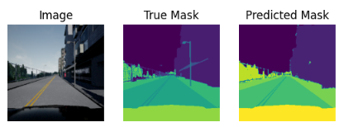
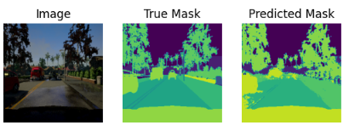
Results
Adam
Test Accuracy: 96.70%
Test Loss: 0.1074
SGD
Test Accuracy: 93.09%
Test Loss: 0.2392
AdaGrad
Test Accuracy: 90.30%
Test Loss: 0.3532

